Slide 1
Care Guardian Edge
Kanchan Ghosh

Slide 2
The Problem
The Solution
Elderly care is costly
There are many elderly
Particular problem with dementia, stroke and other illness
“Dumb Camera” can’t help
AI Agent that manages on your behalf
Analyses images and take action
Recognises specific hand signal
Plays sound for onsite caregiver
Calls and sends SMS to families

Slide 3
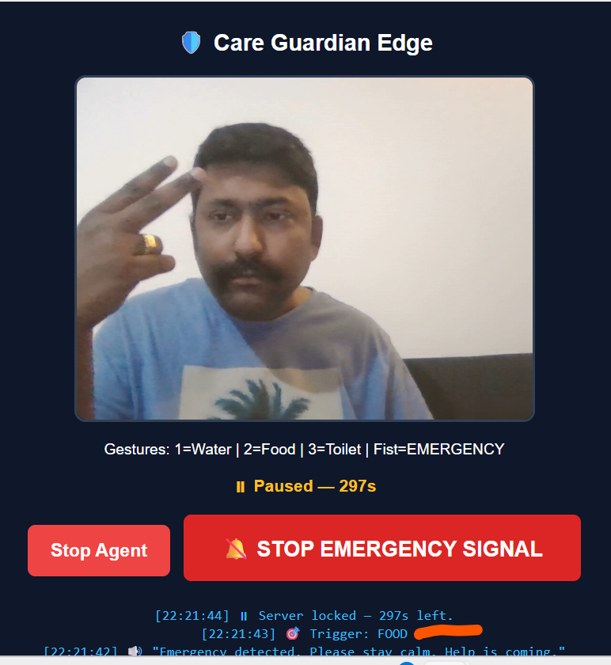
The Technology
Gemini as AI Brain and CV
Python Flask
Whatsapp
Twillio
Jamendo

Slide 4
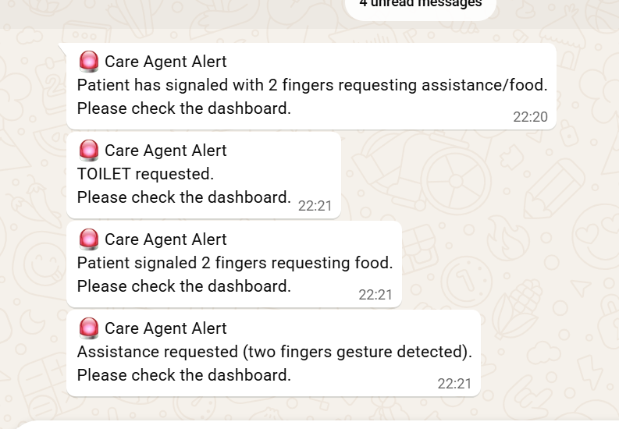
The Market
650M+ elderly population across UK, USA, India, and ChinaPython Flask
0.1% capture = 650,000 households
cheap cameras (£20), free edge ML in-browser, falling LLM vision costs, WhatsApp

Slide 5
The Future
NHS, Govt and Individuals
Agreement with camera and LLM
Expertise in Health Care market
https://www.loom.com/share/a2c70ec370404b8c8be6f46dd0c83675

